Slide 1
Statistical Process Control
Normally some sort of production process
Notes:
Dear students,
I have been studied these chapters in this book, for facilitating you picking up some useful essentials.
This presentation is a short guide through some book chapters.

Slide 2
Lecture Objectives
Student can explain what SPC is
Student understands control charts
Student can design control charts
Student can estimate process capability from control charts

Slide 3
Lecture content
SPC definitions
SPC purpose
Control charts
LSL, USL, C_{p}, C_{pk,} P_{p}, P_{pk}

Slide 4
What is SPC
Definition :(probably one of many)
SPC is the application of statistical principles and techniques in all stages of production directed towards the economic manufature of a product that is useful and has a market

Slide 5
Purpose of SPC
To bring and keep the process under statistical control
To improve the process (and hence the product)
To shift the emphasis from product inspection to process control

Slide 6
Control Charts
The purpose of control charts :
The process is continuously checked and evaluated in order to keep it under statistical control. An important task here is to determine if the process is changing and needs adjustment.
If the process is not under statistical control, then the control chart helps to bring it back under control.

Slide 7
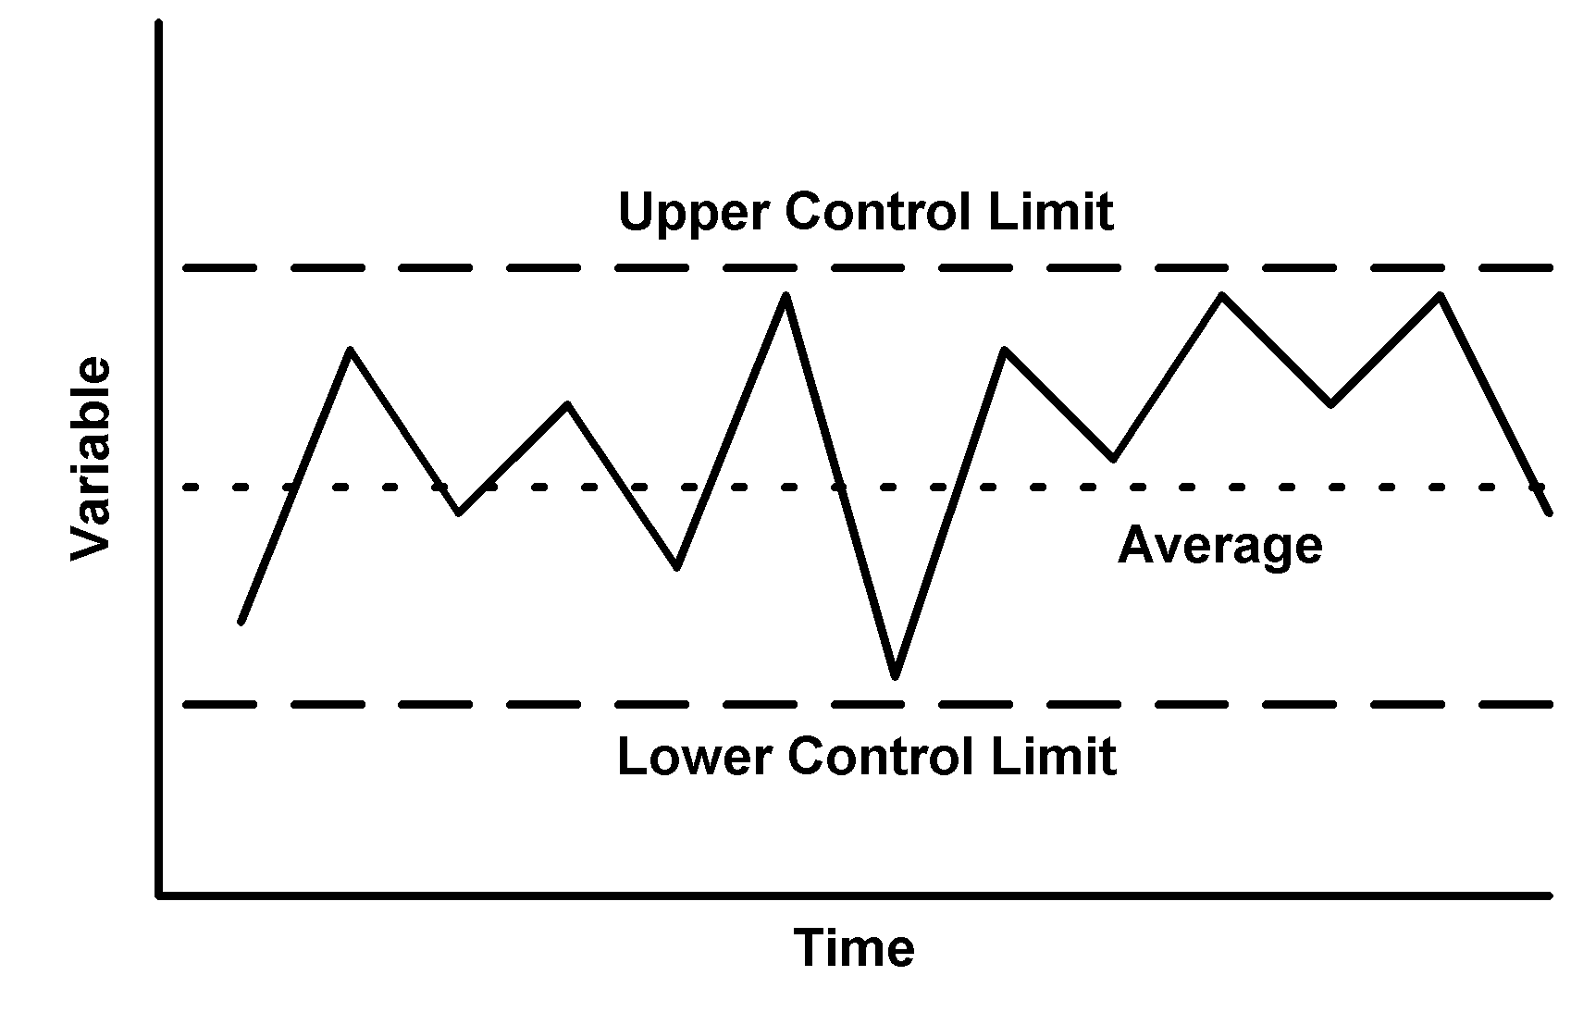
Control Charts
Control charts generally look like this :

Slide 8
Control Charts
Example with some extra information. WHAT ???

Slide 9
Shewhart Control Charts
Quality characteristic is normally distributed, mean μ and stand dev σ
Sample size of n
Gives average and s.d. (x_{av} and s)
x_{av} is also ND, with mean μ and stand dev σ/√n. (WHY ??)
Because of the central limit theorem, the above will also apply if the quality characteristic is not normally distributed. (Why ??)
Mean and sd not normally known, so should be estimated from a number (20-25) of tests when the process is thought to be in control.

Slide 10
Intermezzo: Where did the √ come from?
Rule 1: The variance of a sum or difference of two independent random variables is the sum of the variances.
Variance of (X±Y) = Var(X) + Var (Y)
Example: X~N(av=5,var=20) Y~N(av=3,var=25) If D=X-Y. Then D~N(av=5-3=2,var = 20+25=45)
Rule 2: When a random variable is multiplied by a constant, its variance gets multiplied by that constant squared
Variance of cX = c².Var(X)
Example (continued) If P=2X-3Y then P~N(av=2x5 – 3x3=1,var=4.20 + 9.25 = 305)
Rule 3: (follows from the other two) The variance of a mean of independent random variables, all with the same variance σ , is σ divided by the number of things being averaged.

Slide 11
What was the Central Limit theorem again?
Any distribution with mean µ and variance σ²
normal distribution with mean µ and variance σ²/n

Slide 12
Statistical process Control
Book : Applied stats & probability for Engineers.
Chapter 15 (page 637 →)
In control:
Know what is background noise.
Chance cause of variations. This is all known
Out of control:
Improper production parameters
Operators
Defects
…..
……
{Relatively large when compared to ‘chance cause’}

Slide 13
Methods
Methods to either identify that a system is out of control, or to confirm that it is in control:
X-charts, R-charts, s-charts
Cp, Cpk
All use control limits:
Specification limits (LSL, USL) (for example using tolerance design techniques : later this semester)
Control limits (LCL, UCL), which are not necessarily the same as specification limits

Slide 14
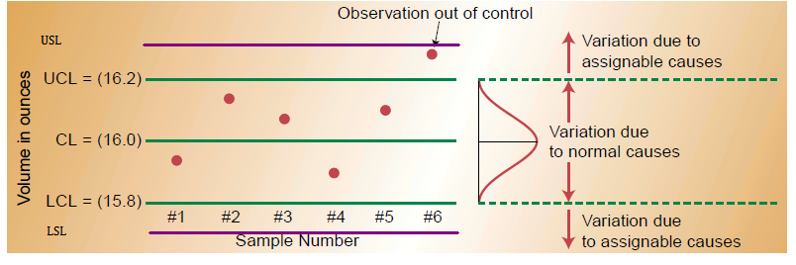

Slide 15
Read through pages 637-649.
One important Conclusion here: A good knowledge of (production) processes is required in order to eliminate causes of errors.

Slide 16
Control charts
There are three types of control charts :
X-charts, R-charts, s-charts
Generally we can say that
X charts monitor quality between samples/batches
R-charts and s-charts monitor quality within samples

Slide 17
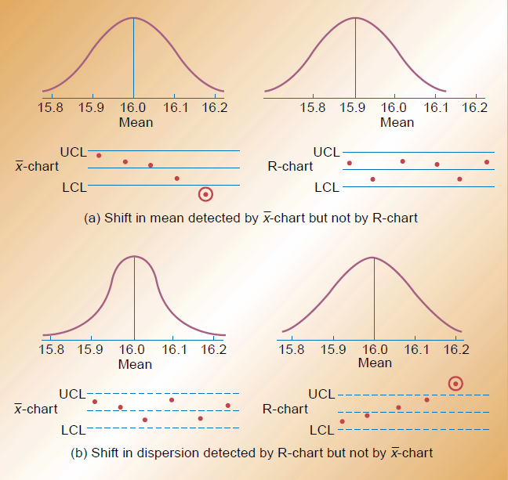

Slide 18
Setting up charts
Step 1 – during a period when you think that the process is under control (Mostly after the pre-production run)
Sample the quality characteristic ‘n’ times (n is typically 4-6)
Giving x11, x12, x13,…..x1n. This can be averaged to give x1
Repeat this ‘m’ times (m=20 @ 25)

Slide 19
Giving
x11, x12, x13,…..x1n → x1
x21, x22, x23,…..x2n → x2
..
..
xm1, xm2, xm3,…..xmn → xm

Slide 20
The ‘red population’ has a normal distribution with average = average of the blue population.
(Central limit theorem)
We can estimate the population mean of the red population:

Slide 21
This is the centre line of the x-chart. Note : This is not necessarily the same as the nominal value from the specifications.

Slide 22
Step 2 Estimate the range:
R1=max{x1i} – min{x1i}
R2=max{x2i} – min{x2i}
…
Rm=max{xmi} – min{xmi}
R = average {R1,R2,….Rm}

Slide 23
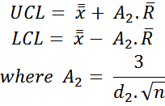

For the x-chart:
Define
A2 and d2 are given in table XI on page 728
(NB: note typo in book : )

Slide 24
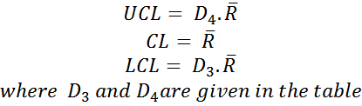
For the R-chart:
Define

Slide 25
Step 3 : check your ‘in control samples’ (i.e.the m.n samples you have based everything on)
If OK: finished
If not OK : rectify

Slide 26
Step 4 :
Use these chart values for production process’.
Revise everything whenever your process changes
Use the s-chart if you have varying sample sizes.
If both the x- and the R-chart show non-randomness, try to eliminate causes in the R-chart first.

Slide 27
The s-chart
If n varies a lot we will prefer to use the s-chart. Also, a lot of standard production software will use s-charts rather than R-charts.
Methods are similar (see eqns 15-14 to 15-17 on page 652).
Note : when using the s-chart, the formulae for the x-chart change slightly (15-17)

Slide 28

The s-chart
Note: Eqn 15-14 should change if you do not have a constant sample size ‘n’.
This is the CL.

Slide 29
Individual measurements
Please read p 658 → for similar methods when we only have n=1

Slide 30

Process Capability
See chapter 15.5 (page 662)
PCR in this book (Process Capability Ratio) also often called ‘Cp’

Slide 31
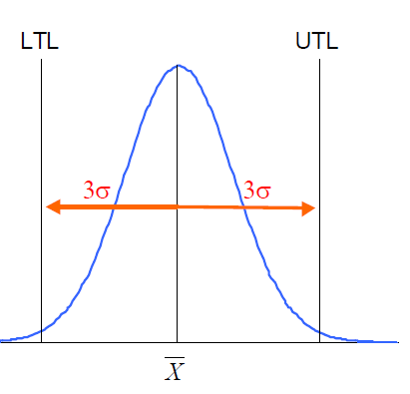

Slide 32
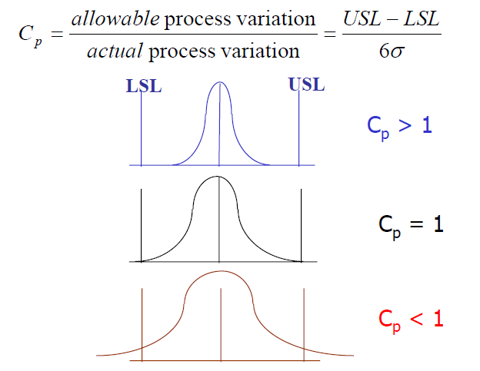

Slide 33
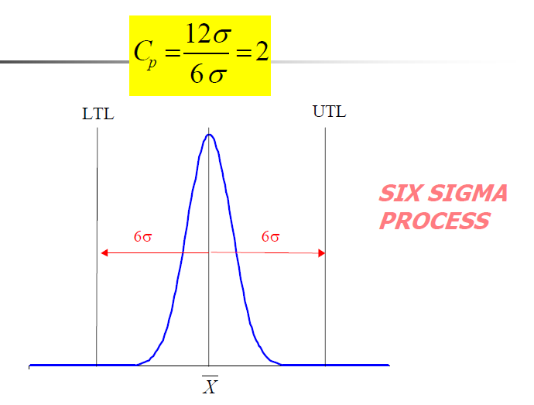

Slide 34
Cp capability Ratings
Cp values | Capability Ratings
Cp > 2.00 | Terrific (Six-Sigma)
1.67 < Cp < 2.00 | Excellent
1.33 < Cp < 1.67 | Good
1.00 < Cp < 1.33 | Fair
0.67 < Cp < 1.00 | Poor
Cp < 0.67 | Terrible

Slide 35
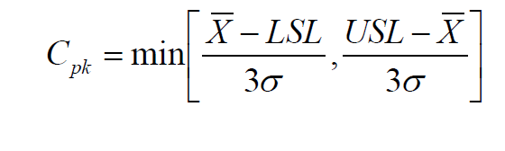
Specification vs Actual
In the definition for Cp we use the specification limits. Another measure would be to use the actual process values.

Slide 36
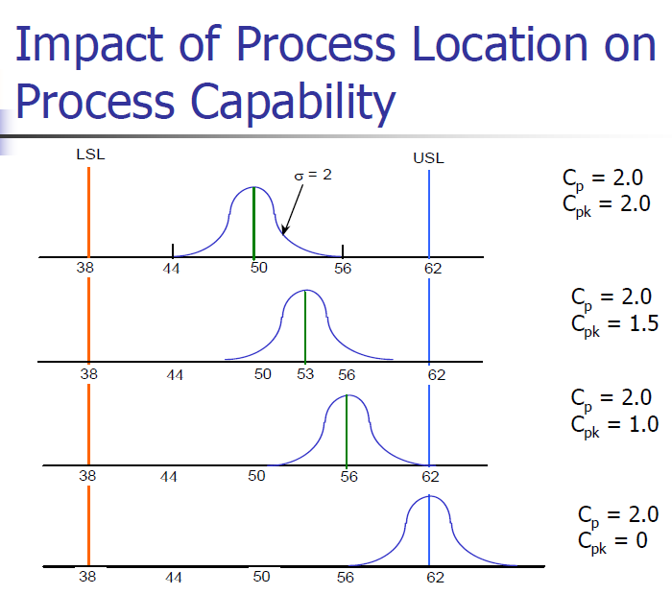

Slide 37
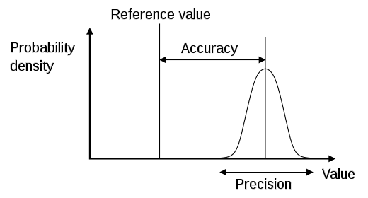


Accuracy and Precision
Compare this with Accuracy and precision

Slide 38
That’s why you will need to investigate Cpk as well as Cp !!
Cp tells us about the width of the curve in relation to our specifications.
Cpk tells us about the positioning of the curve in relation to our specifications.

Slide 41
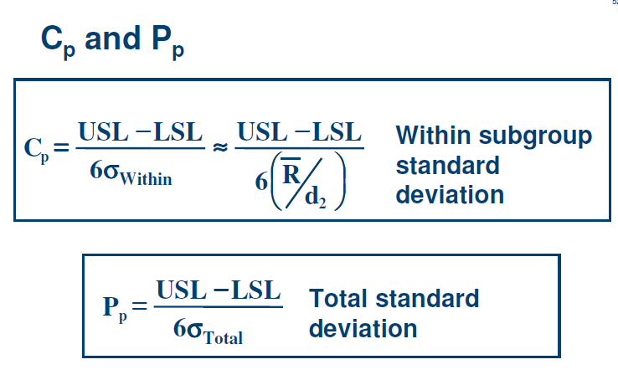

Slide 42
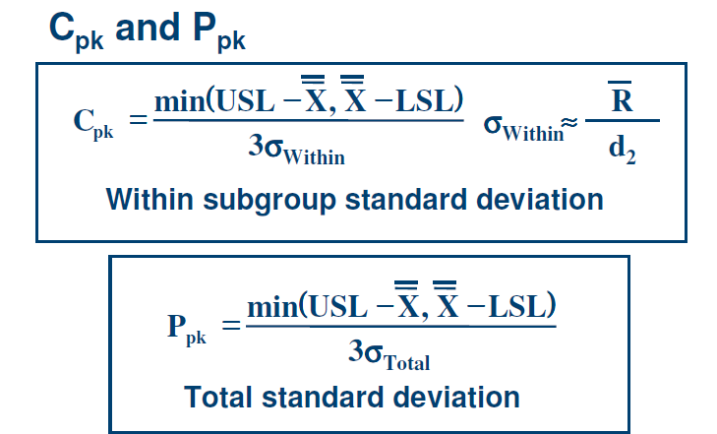

Slide 43
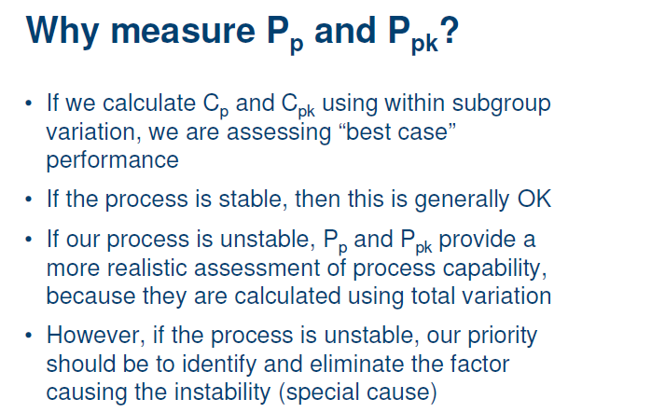

Slide 44
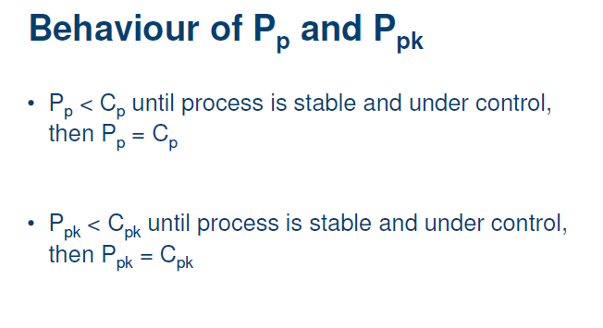

Slide 45


